Slide 1
Salesforce Change Management Best Practices
<CSM Name>
<Date>

Slide 2
Salesforce Change Management
Business Driver
Best Practice Overview
Topics of Discussion
  Managing change on-demand
  Principles of on-demand change management
  Maintaining a quality implementation
Additional Information

Slide 3

Salesforce Change Management

Slide 4




Change Management
A process of continuous evolution
Continuously analyze your current state, collect User feedback and implement change when appropriate
Vision & Strategy
Establish program vision
Define strategy to achieve
Develop objectives to ensure progress
Initiate/Plan
Identify key Salesforce capabilities required
Develop a roadmap to implement
Tie capabilities to program objectives
Initiate/Plan
Vision
Strategy
Objectives
Validate
Audit Salesforce data
Monitor performance metrics
Use results to drive behavior or process change within the organization where appropriate
Operationalize
Build, configure and deploy application
Manage organizational change (release mgmt, training, etc)
Drive adoption of new features
Validate
Operationalize
Validation
Notes:
A well defined Salesforce program, or any application program, is really about continuous improvement.
It starts with a well-defined Vision and Strategy. This identifies for the organization the overall goals for the program. The proverbial, “light at the end of the tunnel” per se in terms of identifying the goal you are trying to achieve. Once you’ve established your Vision, you want to continually initiate and plan various projects that support your Vision. Salesforce does some of this for you with our feature releases; however, it’s important that you too are collaborating with your users and executives and looking for new applications to build or deploy or functionality to introduce that will continually improve the user experience and help drive adoption.
You obviously operationalize those key functional components and then you have in place mechanisms by which you can continually validate your results and course correct if and when necessary.
?? Does your organization have a stated Vision and Strategy for Salesforce that you are aligned towards in focusing your resources and efforts?

Slide 5
On-Demand Development Methodology
A more flexible approach
Business Responsibilities
IT Responsibilities
Daily Changes
Monthly Changes
Reports
Dashboards
List View Management
Documentation Management
User Administration
Solution Management
Communication Templates
Email Templates
Minor Release: Simple configuration changes that do not impact day to day business or require training.
As Required (Target Monthly)
Major Release: New Initiatives and other changes that require training or testing.
Dates determined by Steering Committee
(Target Quarterly)
Notes:
It is critical within any organization to take advantage of the web services model by enabling the business to own some of the core configuration responsibilities while at the same time keeping key control over the environment within IT. Some business however, like to maintain control within one division or another. Should you decide to use the hybrid approach depicted here with the business owning some responsibility and IT others, it will be important to clearly designate the roles/responsibilities of each organization and ensure there is cross-functional collaboration between the teams.
We depict here the types of changes that the business can typically manage and those that IT would typically manage. IT typically takes on the more complex tasks such as integrations, coding, and such.
?? Which group will be managing/administering the Salesforce application?

Slide 6





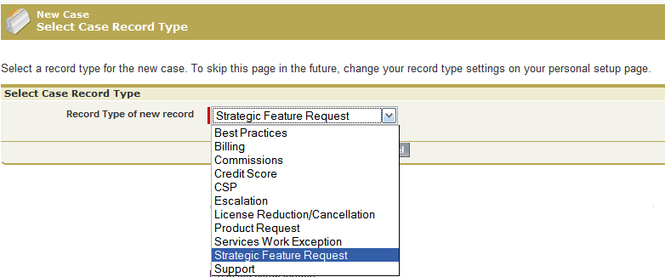
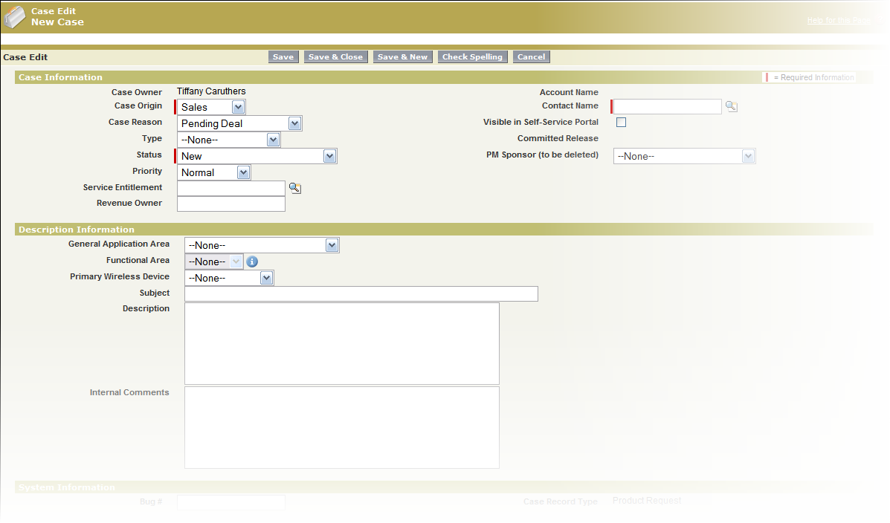
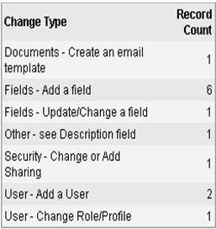
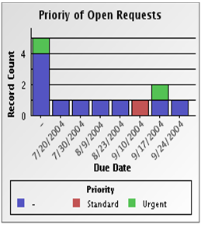
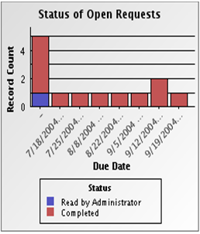
User Feedback & Requests
Suggestions on managing enhancement requests
Implement Salesforce Ideas
Engage all your communities online
Spark conversations
around ideas
Bubble the best ideas to the top
Use Salesforce Cases
Use record types to differentiate case types
Collect required information on the record
Report on the requests received
Notes:
The first principle is to collect ideas and requests from your Users. You obviously have to have a mechanism in place for your users to submit their feedback and requests for consideration. Salesforce offers two best practice tools that we recommend for this purpose:
Salesforce Ideas – in your org today, you have access to configure and deploy Salesforce Ideas to your internal users. You can configure a specific category of ideas around “Enhancement Requests” for example and have your users input their requests and ideas into the Ideas module. Other users can go in and review ideas, vote on them and you can use this as a means to have your users drive the priority of certain requests. Are you familiar with the Salesforce IdeaExchange? If not, this is a forum for Salesforce users to log their ideas directly to our Product Management team for consideration in a future release. PMs will comment on ideas, other users comment and vote on them and our PM team uses this as one of the many tools to determine which items will be in an upcoming release cycle. It’s a great way to get your users involved and engaged in Salesforce and feel they are part of the process with a ‘voice’ per se.
Another way to collect user feedback is through the use of the Case object. It is recommended that, if you use Cases to also track external customer issues, that you create a Case record type for internal enhancement requests. You can collect all of the required information you need to appropriately evaluate the request and also use the built in reports and dashboards to monitor the number, type, frequency of, release schedule, etc. of specific requests. Qualcomm uses the Case object for this purpose and it’s very useful for them from an analytics perspective.

Slide 7
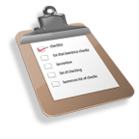
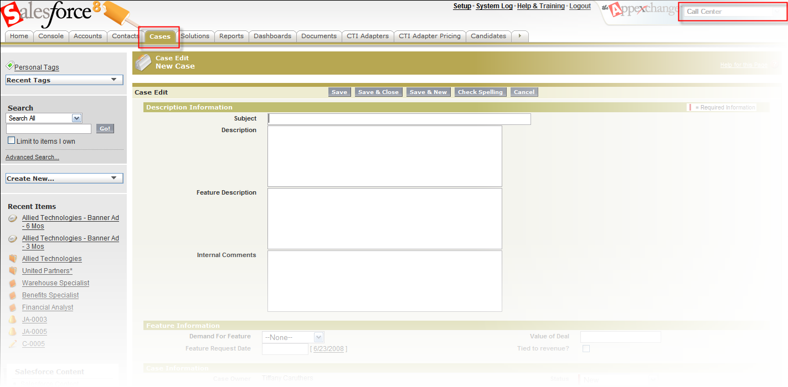

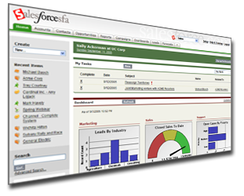
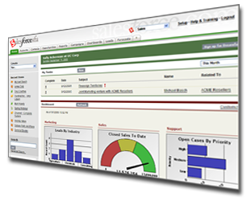
Principles of Change Management
Managing the process
1
2
Collect ideas and requests from Users
Analyze and prioritize requests
4
3
Fully-replicated
Communicate to end-Users about new or changed functionality
Configure/develop and deploy using Sandbox
Notes:
Now we are going to get into the 4-major principles of change management. We’ll review principles 1, 2 and 4 at a very high level and spend a bit more time diving into principle 3.

Slide 8


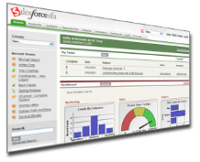
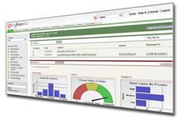
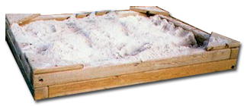

Managing Configuration Changes
Best Practices
Development
Testing
Training
Notes:
Force.com Sandbox combines the best of both worlds: you get a separate test environment plus all the benefits that the on-demand model provides. You can refresh your Sandbox environment, every 30-days, with a single click in order to keep your production environment and your development and test environment in synch.
Definitely as a best practice, Salesforce recommends that you build more complex types of configuration changes in Sandbox and test them fully before migrating those changes to production. Items you should consider in Sandbox are:
Work-flow and approval processes
Integration changes
Role hierarchy changes
Sharing rule changes or additions
Territory changes
Apex code or Visualforce enhancements
Building of new custom apps

Slide 9
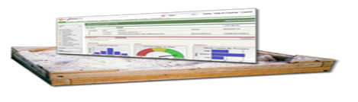





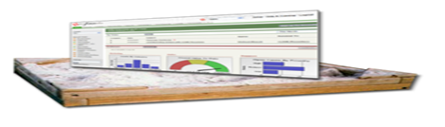

Refreshable Sandbox Environment
The process
Source Control
Updated production configuration
User testing in full UAT sandbox
CVS
Start
One-Click Refresh
Refresh sandboxes
Parallel development in config only dev orgs
Notes:
The process to refresh your production environment to Sandbox is pretty simple.
First, you access the Sandbox through the Set-up menu under Data Management | Sandbox. You must be in the production org to initiate the refresh. If your environment is available to be refreshed, you can select to refresh. This process may take several minutes. Requests to refresh Sandbox are queued and you’ll receive a notification when the refresh is complete.
Once you have refreshed your Sandbox environment, you can make your configuration updates in Sandbox. You can then use Sandbox as your unit testing grounds to validate the changes and conduct regression testing.
After unit testing is complete, you can invite your Users to log into Sandbox and conduct UAT. This is a great place for user testing because you have the most up to date configuration; as well as, data available for the users to work from.
After all testing is complete, you can use the migration tools that are provided by force.com to migrate the changes – or you can migrate some of them manually if the change is not part of the Metadata API (which we’ll talk about next) or is simple enough that you don’t need a specific tool to help migrate.

Slide 10
Using the Metadata API
What is available?
Custom fields
Custom objects
Apex classes
Apex triggers
Apex components
Visualforce pages
S-controls
Record Types
Profiles
Field level security
Custom applications (tabsets)
Custom tabs
Documents
Folders
Package
Weblink
Email template
Letterhead
Picklist/Record Type map
Custom buttons
Static resources
Custom links
Workflows
Page layouts
Page layout assignments
Home page components
Home page layouts
Validation rules
Approval processes
Custom report types
Tab and field renaming
Button overrides
Field dependencies
Picklists
Dashboards
Reports
List views
Queues
Public groups
Email attachments
Tag API ^{New!}
Other Enhancements to our MetaData API are planned for the future
Notes:
Here is a list of all of the items that are accessible using the Metadata API. Using the Force.com IDE, the Metadata Ant task, or an AppExchange app like Dreamfactory Snapshot will help you more quickly move configuration changes between your environments.

Slide 11

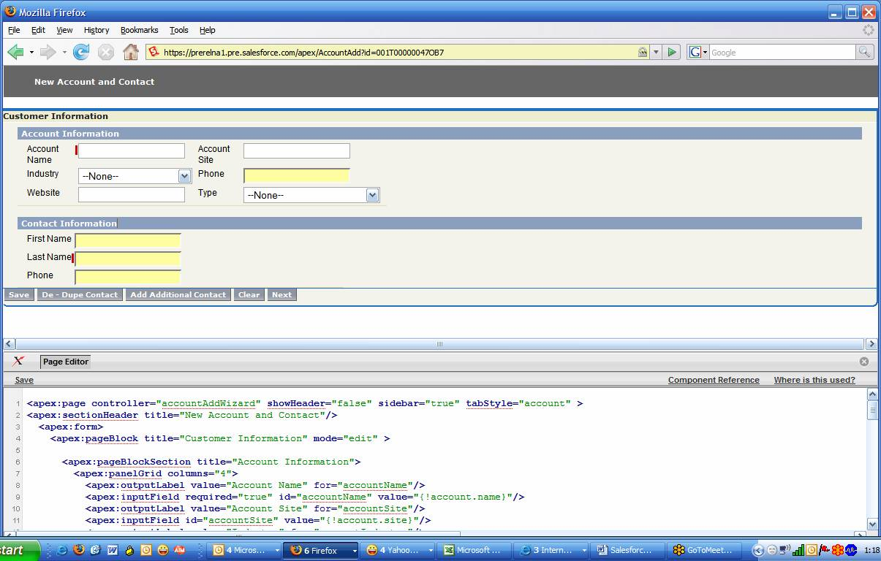



Migrating Changes
Moving data from Sandbox to Production – Force.com tools
Multiple Sandbox Environments
IDE
Production Deployment
Develop
Test
Train
Version Control
CVS
Notes:
Here is how all the pieces come together. The IDE is at the center controlling the movement of code between environments and the source control system.
The Force.com IDE can Integrate with most Version control management systems including Subversion, CSV, Perforce and Google Code.
If you want or need more detailed information on these tools, let’s discuss setting up a more in-depth technical discussion with one of our technical resources that can walk you through how to effectively utilize these tools.

Slide 12

Migrating Changes
Moving data from Sandbox to Production – partner tool
Save snapshots of configuration
  Metadata read from WSDL
  Written to local XML files
  No user data read/stored, only metadata
Benefit: track and document org changes
Compare side-by-side
  Multiple snapshots – 2 or more
  See similarities, differences, both
  Evaluate changes over time
  View configuration of entirely different orgs
  Dissect changes in user privileges – object permissions, security settings, field visibility
Notes:
Snapshot is an Appexchange application published by Dreamfactory that allows you to track, manage and promote changes to object, field, profile and other “metadata” customizations inside Salesforce. You can also track the changes using Snapshot so you can do a side-by-side comparison of the configuration before and after the change. This is helpful too in troubleshooting. Further, you can roll changes between the environments which obviously makes it easier for you to manage and track the changes.
If you’re interested in a tool like Snapshot, let me know and I can coordinate a meeting or demo with the vendor and help facilitate the evaluation process.

Slide 13
Controlling Change
Mitigating risk when introducing change
Before migrating any data changes from Sandbox to production you should always make a back-up copy of your production organization data
  Data back-ups: Setup | Data Management | Data Export
  Data exports can be run immediately or scheduled
  Use the Data Loader to restore the data to the previous state
  Appropriate for territory changes, assignment changes (i.e. account or case transfers), etc.
Copies of your configuration can be made using tools such as Snapshot
Control administrative access to your org
  Allow only a certain number of users full access to make configuration and data changes
  Implement an oversight committee to review/approve changes before they are made
  “Flip” the profile for Users if necessary to toggle between admin and standard user privileges – use custom profiles to define specific parameters for what a User can do without full fledged Admin access
Notes:
Sometimes, things may not work out the way you planned or expected so it’s important that you have control processes in place to restore your current state as quickly as possible.
Relative to data migration, it is always a best practice to export your current Salesforce data before importing, updating or deleting records in Salesforce. You can perform data exports whenever necessary. We typically recommend that customers back up their data at minimum on a monthly basis but more often depending on the complexity of your org and the types of changes you’ll be making.
You can use tools such as Snapshot that we discussed before to capture current configuration state.
You should always control who in your organization has access to administer the tool. Make sure that the right individuals with the correct level of oversight are in place so you can control and mitigate configuration issues. It is typical for organizations to designate “one time” or immediate access to allow configuration changes. They flip the profile for the user to Sys Admin for a period and then change it back when the changes are made. Organizations such as Kaplan Financial do this currently.

Slide 14

Maintaining Compliance
(CobIT, ITIL, International Organization of Standardization ISO standards)
Typical compliance requirements for change management are:
  Changes are appropriately tested and validated
  Only approved changes are deployed into production
  Records are maintained to indicate the successful test, validation and approval of the change prior to deployment
Typical change management process
Develop
Test
Test and validate changes
Review and approve the change
Deploy into production
Typical compliance documentation requirements
Records of approval from appropriate approval authority
Records of changes deployed into production
Records of testing and validation results
Notes:
In today’s highly regulated environment, many organizations are required to comply with various regulatory standards. Maintaining compliance in an on-demand, multi-tenant environment such as Salesforce.com is really no different than standard IT compliance processes that your organization may have in place.
First, it’s important that all changes are appropriately tested and validated. This can be accomplished through system test and/or user testing. Secondly, only approved changes should be deployed to production. Typically this means that the system manager or owner is responsible for approving the changes before deploying them to production. Lastly, records of the successful testing, validation and approval should be maintained and kept on file to record that the appropriate steps were followed prior to introducing the change in production. You can use internal ticketing applications to record and manage the process or use the Salesforce application (i.e. create a custom object and business process) to manage your change control process.

Slide 15
Principles of Change Management
Managing the process
1
2
Collect ideas and requests from Users
Analyze and prioritize requests
4
3
Fully-replicated
Communicate to end-Users about new or changed functionality
Configure/develop and deploy using Sandbox
Notes:
Now we are going to get into the 4-major principles of change management. We’ll review principles 1, 2 and 4 at a very high level and spend a bit more time diving into principle 3.

Slide 16
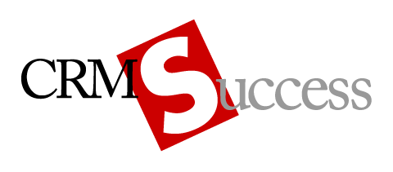
Questions & Feedback

